Slide 1
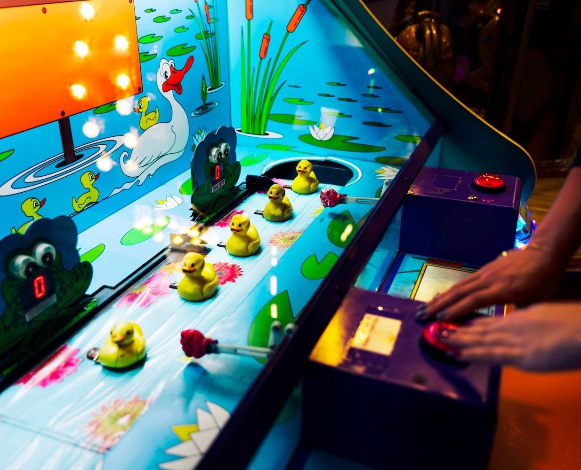
PYTHON TAKES FLIGHT: HOW TO CREATE YOUR OWN ADDICTIVE 2D GAME LIKE FLAPPY BIRD

Slide 2
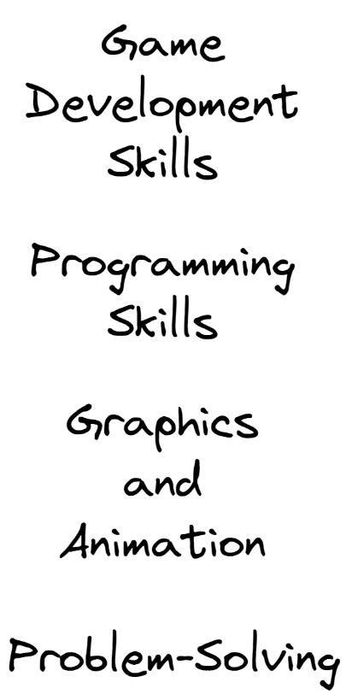

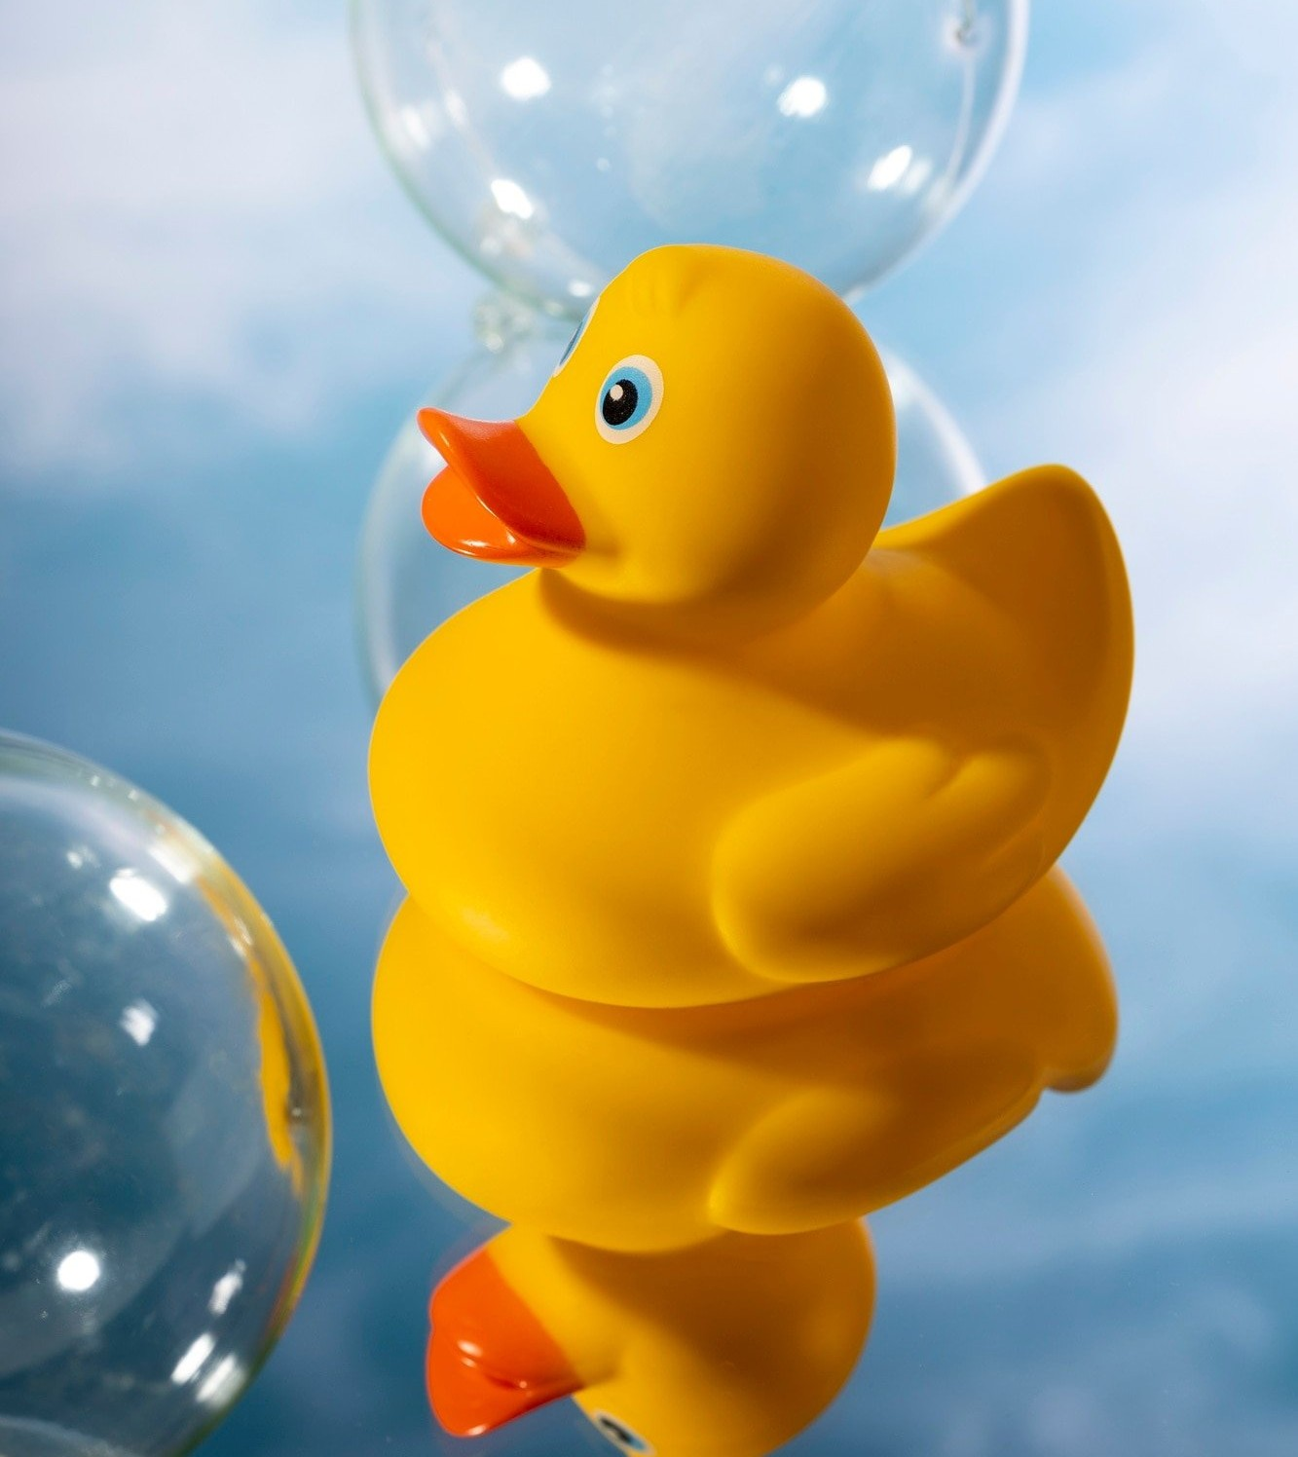
Solution

Slide 3

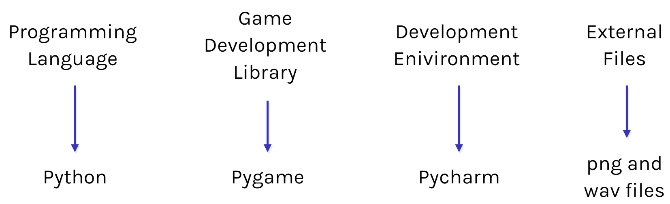
Tech Stack

Slide 4
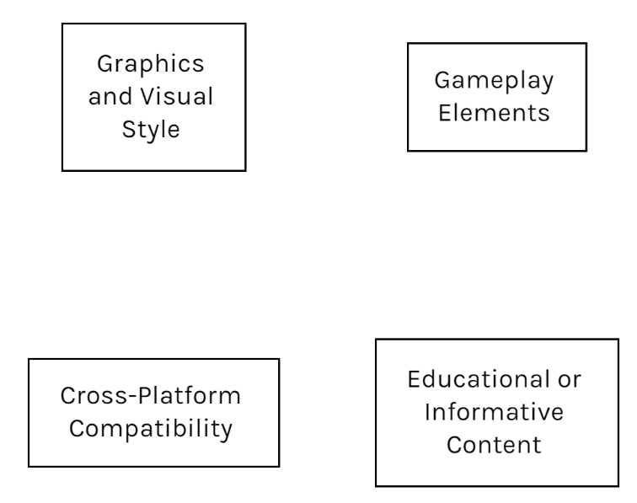
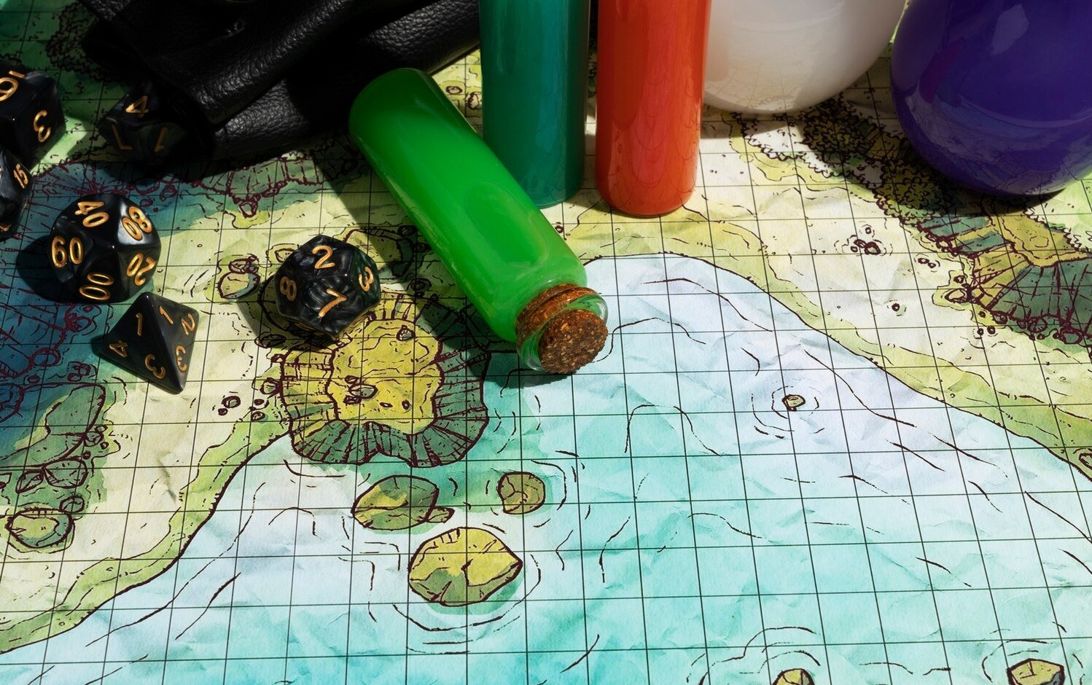
Innovation

Slide 5
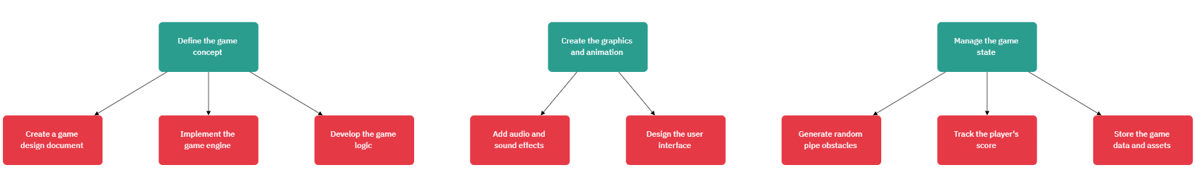
Architecture

Slide 6
Thank You
Any questions?
Feel free contact us
bhatiasahil1515@gmail.com
jainamkhandhar@gmail.com

